Slide 1
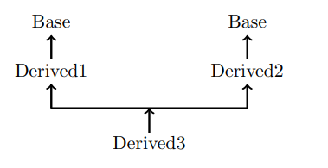
Inheritance
Virtual Base Classes
A potential problem exists when multiple base classes are directly inherited by a derived class.
To understand what this problem is, consider the following class hierarchy:

Slide 2
Inheritance
Virtual Base Classes
Base is actually inherited twice by Derived3- first it is inherited through Derived1, and then again through Derived2.
This causes ambiguity when a member of Base is used by Derived3.
To solve this ambiguity, C++ includes a mechanism by which only one copy of Base will be included in Derived3.
This feature is called a virtual base class.

Slide 3
Inheritance
Virtual Base Classes
In this situation, a derived class indirectly inherits the same base class more than once,
It is possible to prevent two copies of the base from being present in the derived objects by having that base class inherited as virtual by any derived class.
The virtual keyword proceeds the base class access specifier when it is inherited by a derived class.

Slide 4
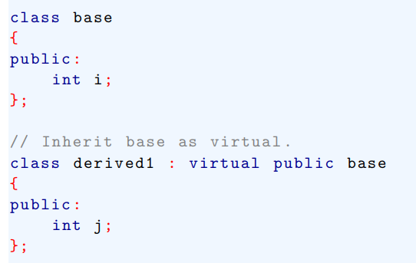
Virtual Base Classes
Here is an example that uses a virtual base class to prevent two copies of base from being present in derived3.

Slide 5
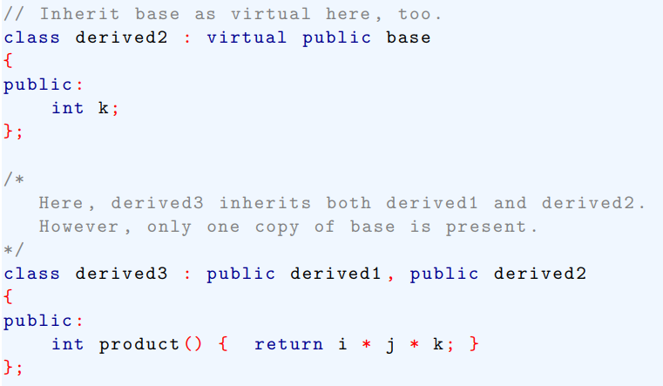
Virtual Base Classes

Slide 6
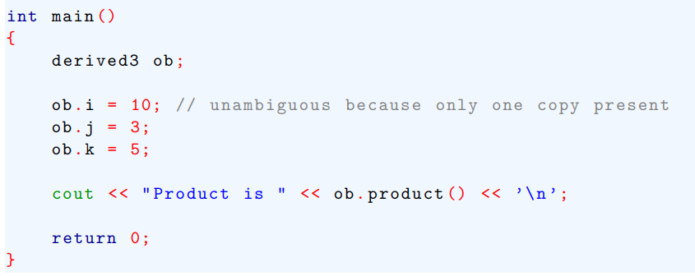
Virtual Base Classes

Slide 7

Virtual Base Classes
If derived1 and derived2 had not inherited base as virtual, the statement
Would have been ambiguous and a compile-time error would have resulted.

Slide 8

Virtual Base Classes
It is important to understand that when as base class is inherited as virtual by a derived class, that base class still exists within that derived class.
For example assuming the preceding program, this fragment is perfectly valid:

Slide 9
Virtual Base Classes
The only difference between a normal base class and a virtual one occurs when an object inherits the base more than once.
If virtual base class are used, only one base class is present in the object.
Otherwise, multiple copies will be found.

